Slide 1

Hi,
I’m Joohyun,
Data Analyst.
Financial Analyst / Securities Expert / Market Researcher

Slide 2
About me
My favorite operation is arrange the patterns through the littered data, drawing the conclusion and analyzing the patterns based on the sorted data for a better or new project.
By carefully analyzing the data, I can presuppose the trend and extract valuable data are in my interesting.
Forecasting stock return volatility, performance, fluctuation by sorted data and graph is what I am good and interesting.

Slide 3
Skills & Experiences
Analysis : Tasked to analyze market industry fluctuations as the Global Market Research team lacked technical analysis tools.
Trilingual : Analyze finance and international economic market focused on Spain and South America with three different languages(Korean, English, Spanish).
TIMELINE
Korea Economic
Research Institute
Kiwoom Securities
Korea Investment&
Securities
E*TRADE
2008
2010
2011
2013
2014
2015
2019

Slide 4










Google Analytics
JAVA
PYTHON
PowerBI
Javascript
HTML
CSS
Weka

Slide 5


“Joohyun is an excellent Analyst and faultless technician. She’s a pleasure to work with, great value for money and will always go the extra mile when necessary.”
José Miguel
Lead Software Engineer at E*TRADE
“Joohyun is not only great for analysis and development, she is a problem solver who always delivers an exceptional quality of work. Highly recommended.”
Shensly hoopot
Software Engineer at Three Labs

Slide 6
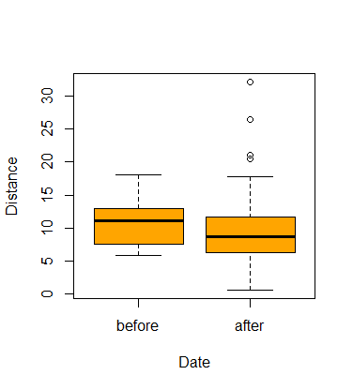
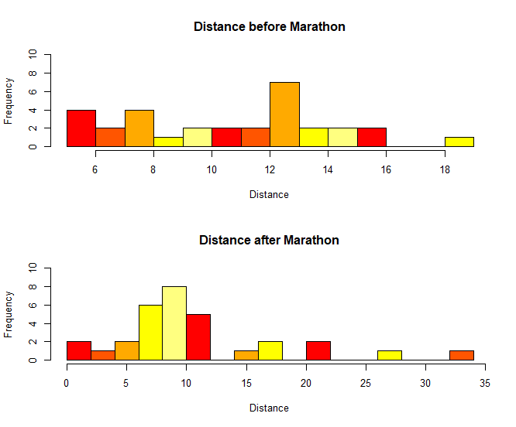
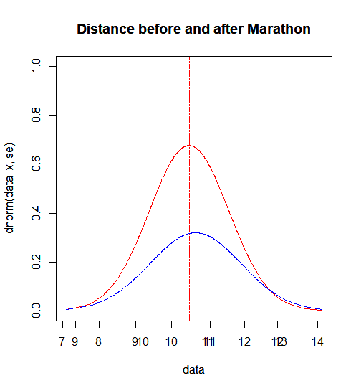
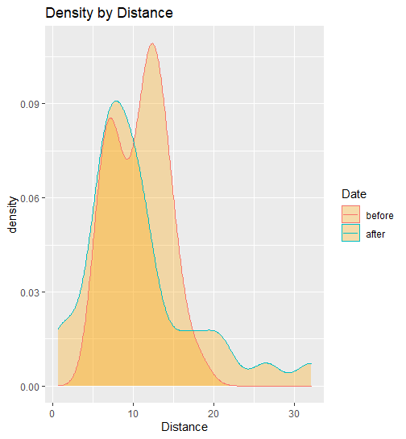
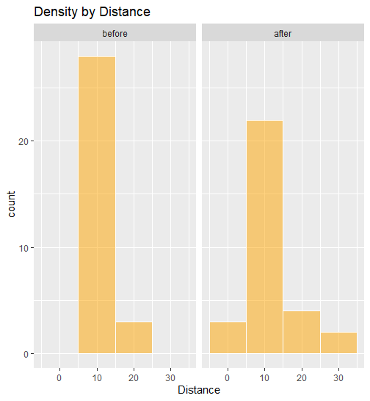
Analysis Model 1. Independent Sample T-Test “Running Records(2015-2020)”
Structure of Dataset
The dataset consists of 28 variables and over 28,028 observations exist from Garmin*.
Univariate Plots
*Source : https://connect.garmin.com/modern/profile/jm8nav

Slide 7
Analysis Of Variance
F test to compare two variances
Alternative Hypothesis has been applied. P value is less than 0.05, there is difference between before and after data.
Two Sample t-test
There is statistically meaningful difference between before and after data which is distance by before the Marathon is higher than after Marathon.
data: Distance by Date
F = 0.22649, num df = 30, denom df = 30, p-value =
0.0001091
alternative hypothesis: true ratio of variances is not equal to 1
95 percent confidence interval:
0.1092073 0.4697271
sample estimates:
ratio of variances
0.2264898
data: Distance by Date
t = 0.026937, df = 60, p-value = 0.9786
alternative hypothesis: true difference in means is not equal to 0
95 percent confidence interval:
-2.741324 2.816162
sample estimates:
mean in group before mean in group after
10.68677 10.64935

Slide 8
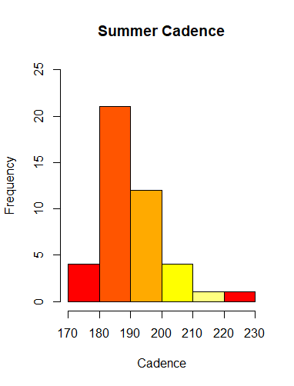
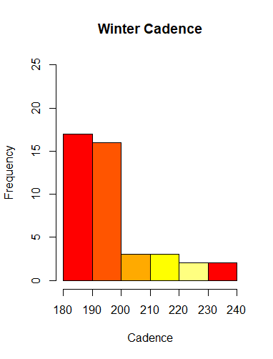
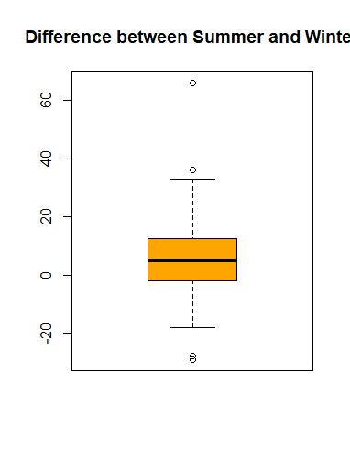
Analysis Model 2. Paired Sample T-Test “Running Records(2015-2020)”
Structure of Dataset
The dataset consists of 28 variables and over 28,028 observations exist from Garmin *.
Univariate Plots
*Source : https://connect.garmin.com/modern/profile/jm8nav

Slide 9
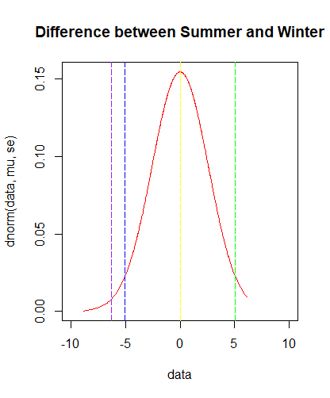
Analysis Of Variance
Paired t-test(Hypothesis : the cadence of Summer and Winter is same)
Season affects to cadence according to mean of the differences(-6.302326).
t.test(summer,winter,
alternative = c(‘two.sided'),
paired = TRUE,
conf.level = 0.95)
data: summer and winter
t = -2.4406, df = 42, p-value = 0.01896
alternative hypothesis: true difference in means is not equal to 0
95 percent confidence interval:
-11.513654 -1.090997
sample estimates:
mean of the differences
-6.302326

Slide 10
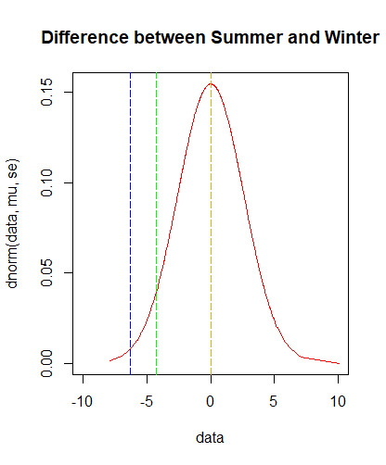
Analysis Of Variance
Paired t-test(Hypothesis : the cadence of Summer ls shorter than Winter)
The result after verify between summer running and winter running, it turns difference out between them statistically which summer is shorter than winter(t= -6.302326, p=0.01896).
t.test(summer,winter,
alternative = c('less'),
paired = TRUE,
conf.level = 0.95)
data: summer and winter
t = -2.4406, df = 42, p-value = 0.009481
alternative hypothesis: true difference in means is less than 0
95 percent confidence interval:
-Inf -1.95899
sample estimates:
mean of the differences
-6.302326

Slide 11
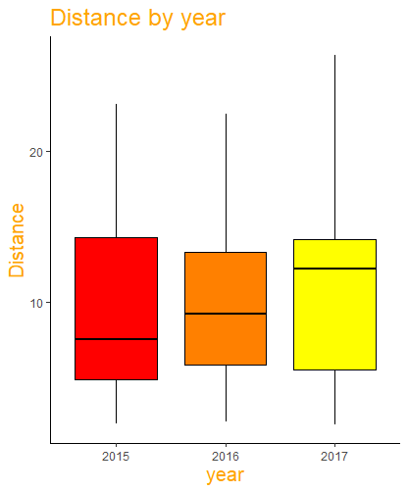
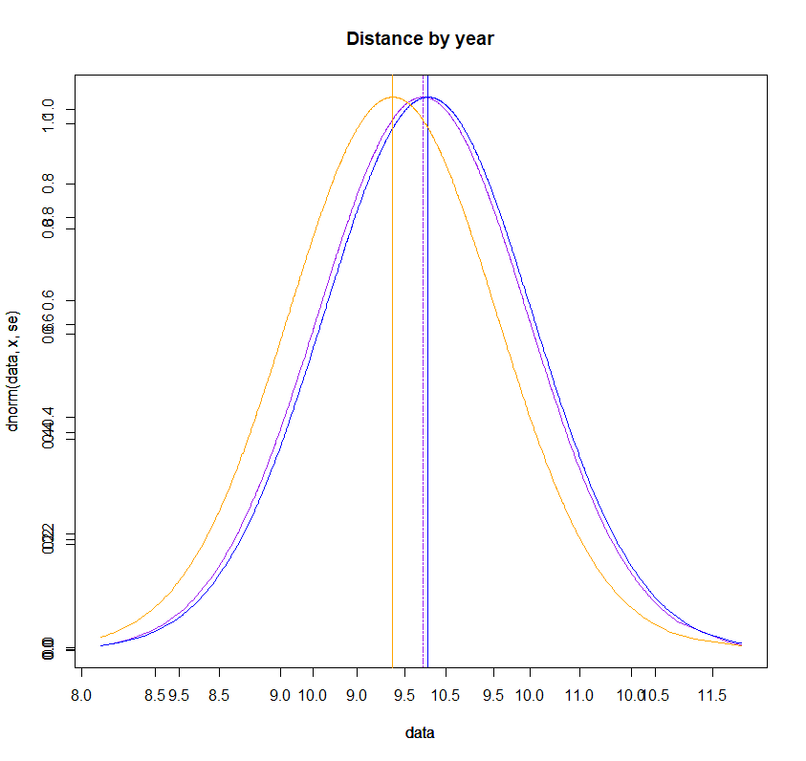
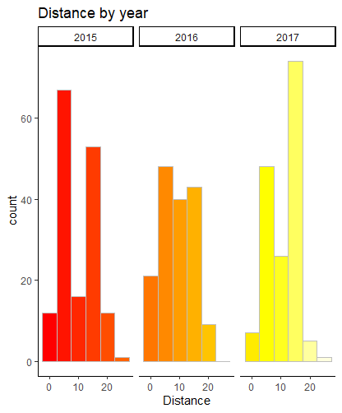
Analysis Model 3. One-Way ANOVA(Analysis of Variance) “Running Records(2015-2017)”
Structure of Dataset
The dataset consists of 28 variables and over 19,768 observations exist from Garmin *.
Univariate Plots
How different distance between each years?
*Source : https://connect.garmin.com/modern/profile/jm8nav

Slide 12
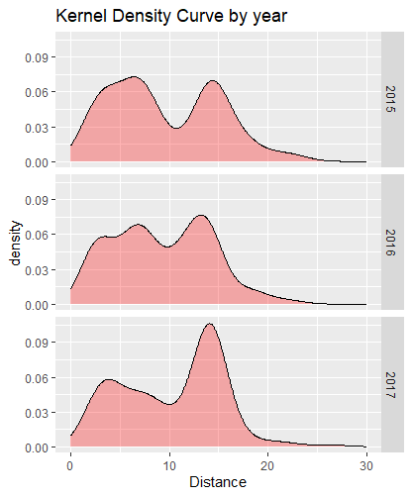
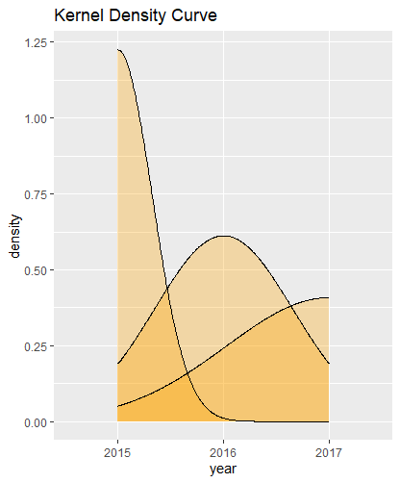
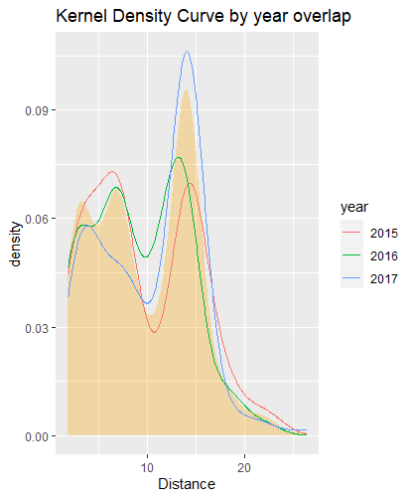
Analysis Of Variance
How different distance between each years?

Slide 13
Analysis Of Variance
Bartlett Test for homogeneity of variances
Hypothesis : The distance in every years might same(Distance~year, data=distance).
Study : The distance in each years might not same.
Result : Every cases have been studied at same conditions.
The variances of 3 groups are different, that is, 3 groups has different conditions.(p-value = 0.4114)
Tukey’s HSD Test for Multicamparison test
> bartlett.test(Distance~year, data=distance)
Bartlett test of homogeneity of variances
data: Distance by year
Bartlett's K-squared = 1.7766, df = 2, p-value = 0.4114
> distance=aov(Distance~year, data=distance)
> summary(distance)
Df Sum Sq Mean Sq F value Pr(>F)
year 2 92 46.14 1.763 0.173
Residuals 480 12563 26.17

Slide 14
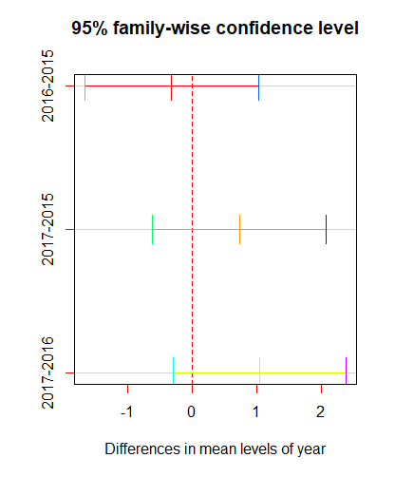
> TukeyHSD(distance)
Tukey multiple comparisons of means
95% family-wise confidence level
Fit: aov(formula = Distance ~ year, data = distance)
$year
diff lwr upr p adj
2016-2015 -0.3141615 -1.6547300 1.026407 0.8460370
2017-2015 0.7293789 -0.6111896 2.069947 0.4076499
2017-2016 1.0435404 -0.2970282 2.384109 0.1608803
Analysis Of Variance
Hypothesis : The number of sample by group is same.
Study : Do turn the differences out between each groups with Post-Hoc Test. Because there are gaps by groups.
The gap between 2015 and 2016 is the biggest, the gap between 2016 and 2017 is the smallest.
c
c

Slide 15
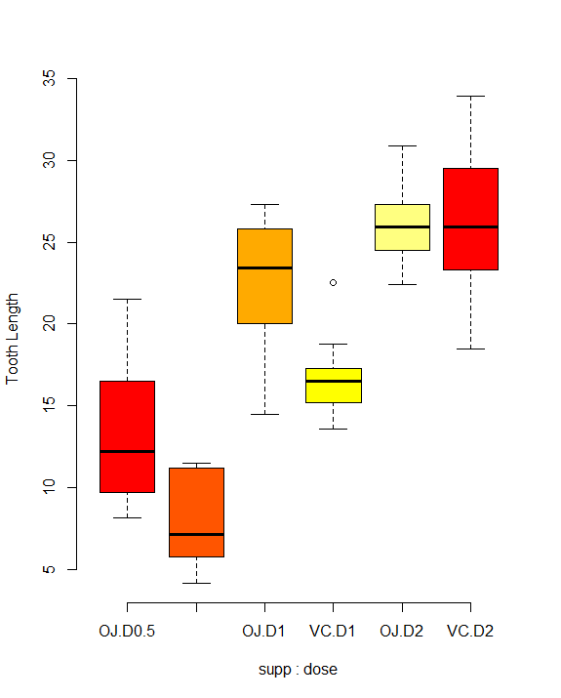
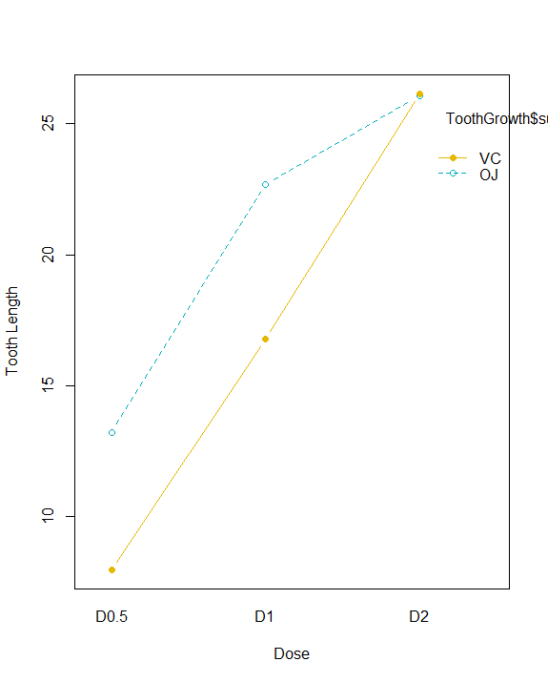
Analysis Model 4. Two-Way ANOVA(Analysis of Variance) “ToothGrowth”
Structure of Dataset
The dataset consists of 3 variables and over 60 observations exist in R.
Univariate Plots(Interaction plot)
How different the mean between supplement and dose?

Slide 16
Analysis Of Variance
Levene's Test for homogeneity of variances
There is meaningless homogeneity of variances(Pr=0.1484)
Two-way ANOVA Test(Hypothesis : All means are same)
Hypothesis : Two variables are independentaov(len~supp+dose, data=ToothGrowth).
Result : There is statistically meaningful both of supp and dose(supp Pr=0.000429, dose Pr=2e-16)
There are gap in supp depends on dose, and vice versa.
> leveneTest(len~supp*dose, data=ToothGrowth)
Levene's Test for Homogeneity of Variance (center = median)
Df F value Pr(>F)
group 5 1.7086 0.1484
54
> #Hypothesis I :
> tooth.aov1=aov(len~supp+dose, data=ToothGrowth)
> summary(tooth.aov1)
Df Sum Sq Mean Sq F value Pr(>F)
supp 1 205.4 205.4 14.02 0.000429 ***
dose 2 2426.4 1213.2 82.81 < 2e-16 ***
Residuals 56 820.4 14.7
---
Signif. codes: 0 ‘***’ 0.001 ‘**’ 0.01 ‘*’ 0.05 ‘.’ 0.1 ‘ ’ 1

Slide 17
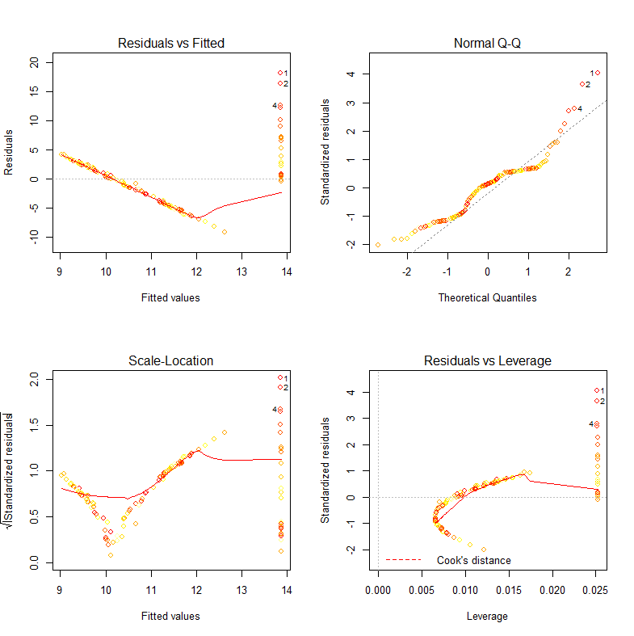
Analysis Model 5. Simple Linear Regression “Running Records(2015-2020)”
Structure of Dataset
The dataset consists of 28 variables and over 28,028 observations exist from Garmin *.
Linear Model Graphs
*Source : https://connect.garmin.com/modern/profile/jm8nav

Slide 18
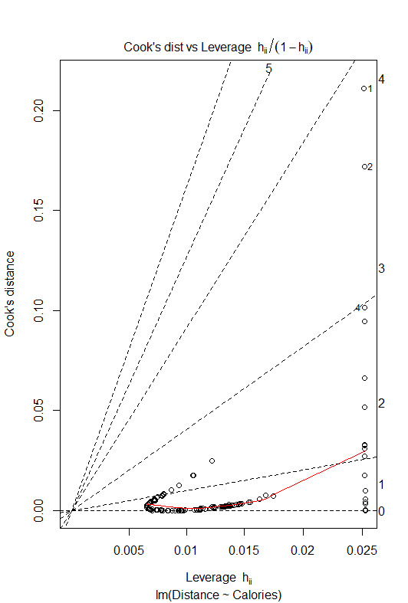
Simple Linear Model Regression
Analysis of Variance Table
Hypothesis : Estimate level of Calories depends on Distances.
When Distance increases as 13.865801, Calories decreases -0.004883
How different between Cook’s distance and Leverage?
> regModel=lm(Distance~Calories, data=regData)
> anova(regModel)
Coefficients:
Estimate Std. Error t value Pr(>|t|)
(Intercept) 13.865801 0.728337 19.04 < 2e-16 ***
Calories -0.004883 0.001115 -4.38 2.21e-05 ***
---
Signif. codes: 0 ‘***’ 0.001 ‘**’ 0.01 ‘*’ 0.05 ‘.’ 0.1 ‘ ’ 1

Slide 19
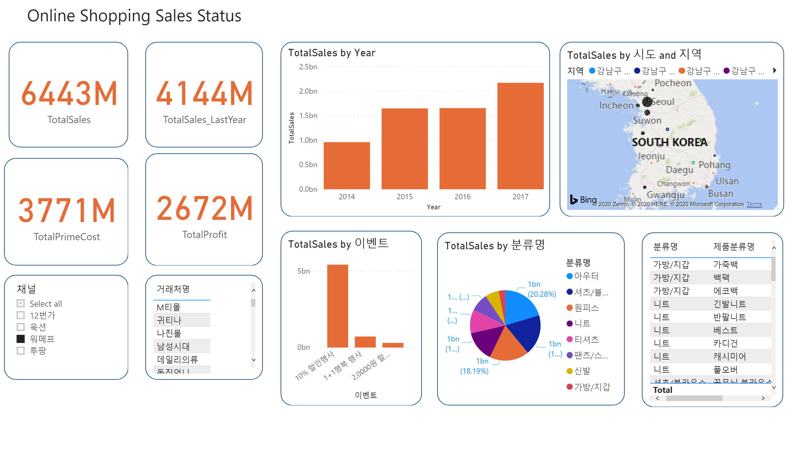
Analysis Model 6. PowerBI “Online Shopping Sales Status*”
*Source : https://2milesgroup-my.sharepoint.com/personal/cathy_2miles_co_kr1/_layouts/15/onedrive.aspx?id=%2Fpersonal%2Fcathy%5F2miles%5Fco%5Fkr1%2FDocuments%2F%EC%9C%A0%ED%8A%9C%EB%B8%8C%5F%EC%83%98%ED%94%8C%EB%8D%B0%EC%9D%B4%ED%84%B0%20%EA%B3%B5%EC%9C%A0%2F%EC%98%81%EC%97%85%20%EB%A7%A4%EC%B6%9C%20%EB%8C%80%EC%8B%9C%EB%B3%B4%EB%93%9C&originalPath=aHR0cHM6Ly8ybWlsZXNncm91cC1teS5zaGFyZXBvaW50LmNvbS86ZjovZy9wZXJzb25hbC9jYXRoeV8ybWlsZXNfY29fa3IxL0VqcFhEVFlMTnJwRnU4QU5hNnMzMlVjQmFBZVd5Tld5bzRBZGJUUmU3aGNtRHc_cnRpbWU9a1FJb1Nscm4xMGc

Slide 20
Let’s work Together
joohyunee.y@gmail.com
https://github.com/mellamonaranja
View More Projects

